Slide 1
IFMS
Steps to Merging Source Code

Slide 2
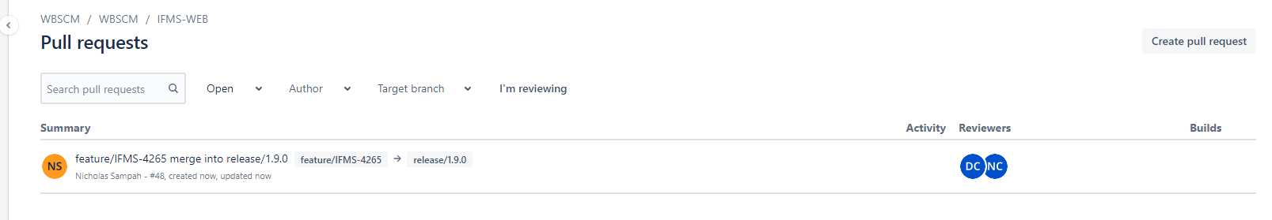
Verify that a pull request exists for the merge change

Slide 3
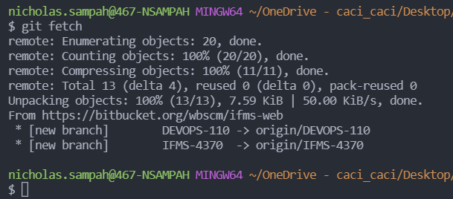
Update Remote Repository Metadata
Command: git fetch

Slide 4
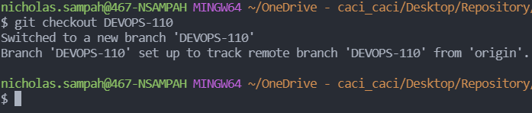
Checkout local copy of branches to be merged
Command: git checkout <branch-name>

Slide 5
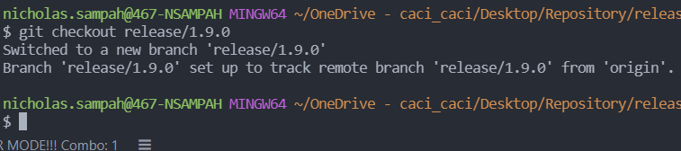
Check out the latest version of the release branch
Command: git checkout release/1.9.0

Slide 6
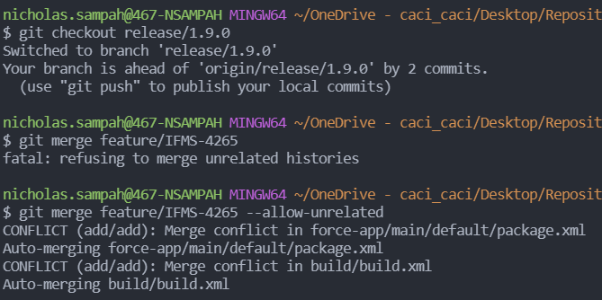
Execute merge command via cli
Command:
  git checkout release/1.9.0
  git merge <feature-branch>
  Use - -allow-unreleated to force Merge if branches are divergent

Slide 7
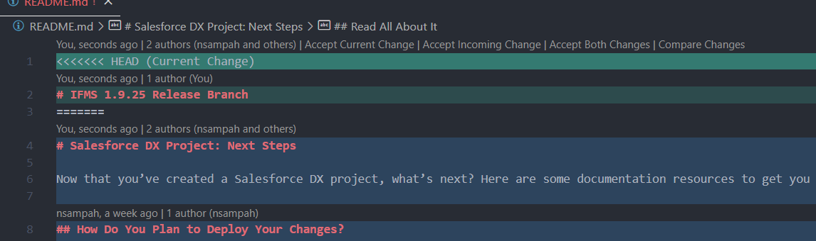
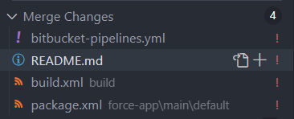
Use Vscode UI to resolve merge conflicts
The section on the left side will be shown on the left hand side of vscode when you have the present directory structure opened as a workspace. All “Merge Changes” are merge conflicts

Slide 8
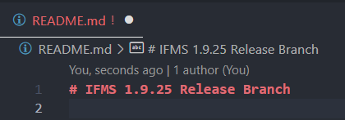
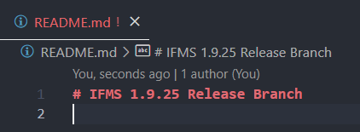
Save updated file of resolved merge conflict
Command: CTRL + s
  You will know this was done successfully when the “white dot” disappears from the top bar of the file
Before
After

Slide 9
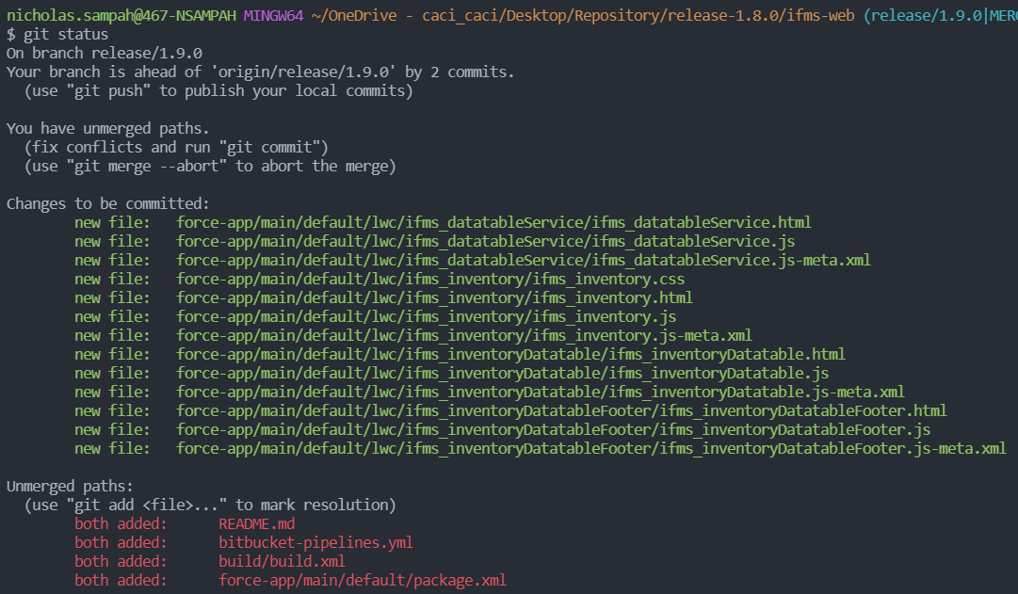
Verify status of changes in local git repository
Command: git status

Slide 10
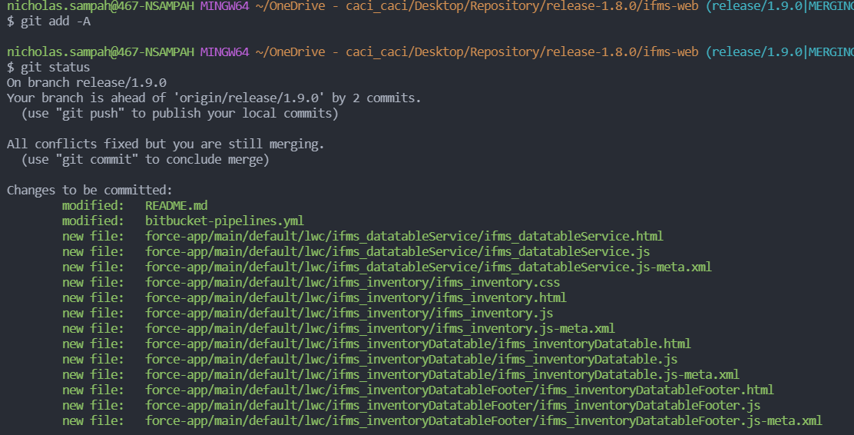
Add all changes to the staging area of git
Command: git add –A

Slide 11
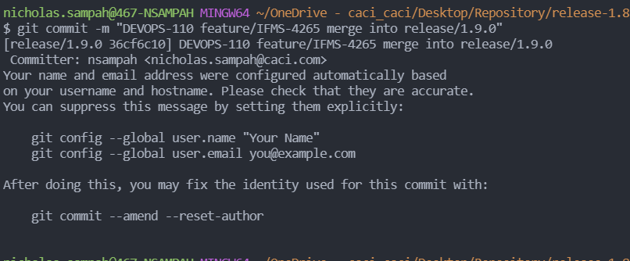
Commit changes to local version of release branch
Command: git commit –m “DEVOPS-111 <feature-123> merge into release/1.9.0”
  Please make sure you have and use a devops ticket number for any release merging commits
  For release 1.9.0 we will use ticket “DEVOPS-111”

Slide 12
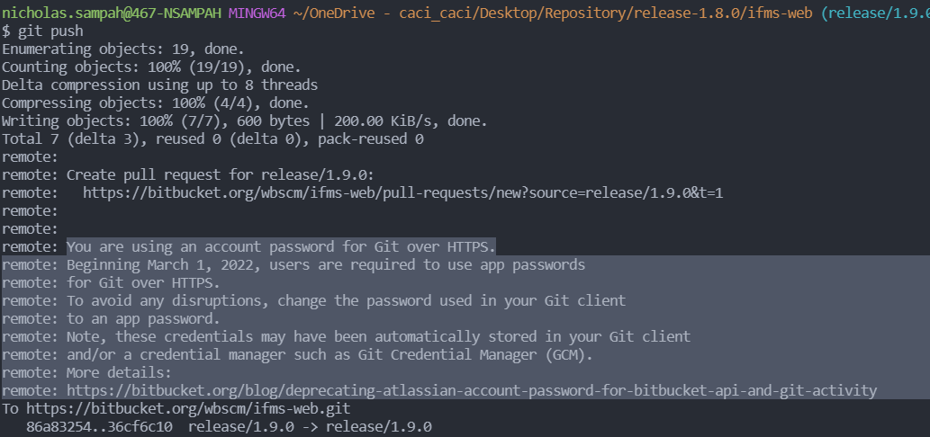
Push changes to the remote repository
Command: git push

